Slide 1
NEW YORK, NY
FLOWERY BRANCH HIGH SCHOOL BAND
MARCH 27-30, 2025

Slide 2
BRT: Since 1981
Founded and owned by a band director
Carried over 650,000 travelers in over 8,000 trips
Disney Youth Programs PremEar Travel Planner
The top producer for Disney Performing Arts OnStage programs at the Walt Disney World® Resort
Recipient of Disney’s prestigious Partners Award
Member of the Student & Youth Travel Association and the National Tour Association
Sponsor of the Illinois Music Education Association, the National Band Association, the American Choral Directors Association, among others
Corporate sponsor of the Make-A-Wish Foundation

Slide 3
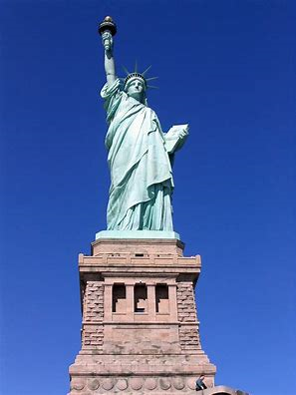
Itinerary Highlights

Slide 4
Trip Inclusions
Round-Trip Airfare (estimated at $500), luggage tags, BRT Airport Representative
Motor coach transportation to and from Atlanta Airport, gratuities for your driver
Motor coach transportation in NYC, gratuities and hotel room for your driver
3 Nights’ accommodations at Fairfield Inn East Rutherford Meadowlands, Breakfast at hotel
1 dedicated private overnight security chaperone
Group dinner at House of Joy and Gayle’s Broadway Rose
Admission to National September 11th Memorial and Museum, Top of the Rock, Statue Cruises to Statue of Liberty and Ellis Island, Step-On Guided Tour of Manhattan
Excursions to the Financial District, Chinatown, Little Italy, 5th Avenue, Times Square, Rockefeller Center, Grand Central Station, Central Park
Ticket to 2 Broadway Shows (show 1 based on $150 seats, show 2 based on $90 seats)
Participation in the Broadway Imagined Up Close Workshop
1 Onsite Company Tour Director, all gratuities throughout the tour
BRT Drawstring Bag for every participant
BRT App – Video Souvenir and Tracking/Messaging features
BRT Payments – Individual Payment System

Slide 5
Estimated Trip Cost & Payment Schedule – **Final Trip Cost depends on number of travelers and cost of airfare
Participant Type | Occupancy
Student (50-53 participants) | $1,749 (all students in quad occupancy)
Chaperone | $1,895 (double) $2,179 (single)
Payment Details | Due Date | Amount Due
Registration | April 24 | No money due
Deposit | May 1 | $250 per traveler plus optional trip protection
2nd Payment | June 3 | $250 per traveler
3rd Payment | September 16 | $250 per traveler
4th Payment | October 15 | $250 per traveler
5th Payment | November 15 | $250 per traveler
6th Payment | January 3 | $250 per traveler
Final Payment | February 3 | Remaining Balance

Slide 6
BRT Payments – How to Register for the Trip
Click on the registration link from the registration form handout: https://bobrogerstravel.grcoll.co/v2/go/flowerybranch25 - TRIP CODE FLOWERYBRANCH25
Follow the steps from the registration form to register. Reserve your spot by entering all information requested in RED and enter a payment method. *A parent must register their child. We will email you along the way – messages may go to spam. Please check your spam folder.
**Complete all the steps (personal & billing information) for your spot to be confirmed (Partial registrations will cause your trip to be cancelled)
You can add Enhanced Trip Protection through TripMate when you register – Enhanced Trip Protection is highly recommended
Secure, online payment system
Receive reminder prior to each payment, select auto-pay for ease
Fund-raising amounts can be easily applied to your account until your account is paid in full
Estimated Trip Cost will depend on number of travelers and the final cost of airfare. The more people that go, the lower the cost will be! (If fewer than 50 attend, the cost will increase)

Slide 7
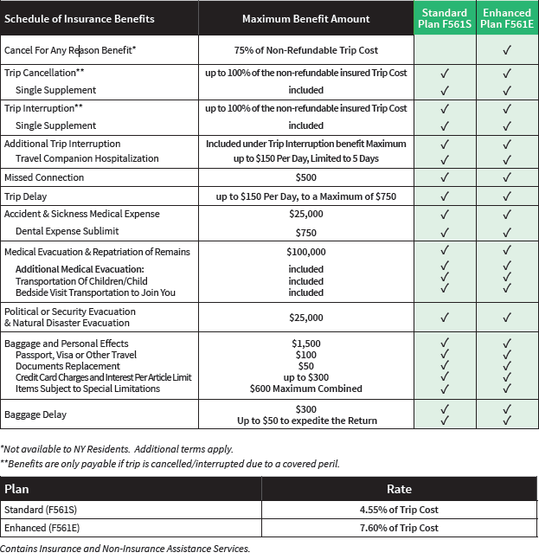
Enhanced (Cancel-For-Any-Reason) Trip Protection
Enhanced Trip Protection is highly recommended and can be added when you register for the trip.
See flyer for coverage details.
As part of your trip registration, you will choose Standard Protection, Enhanced Protection, or decline protection.
Your insurance premium will be charged when you make your trip deposit.
If you want to add Enhanced Trip Protection later, you can log into your account up to 14 days after your deposit to add it.
Questions? A licensed insurance agent can help you when you call the number on the flyer - (844) 777-6856

Slide 8
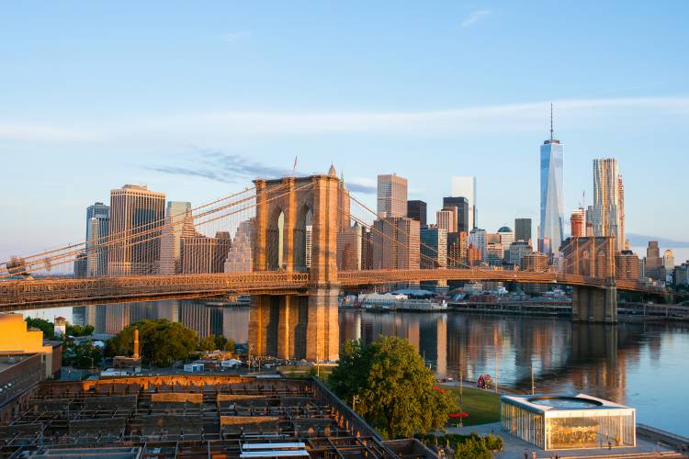
Files You Will Receive
Itinerary
Insurance Flyer
Registration Form
Go online and complete your registration tonight!

